Slide 1
Under-estimated or over budget? Evaluating cost estimate accuracy for federally-funded transit projects
Carole Voulgaris
Harvard Graduate School of Design

Slide 2
Agenda
The Federal Transit Administration’s New Starts Program
Common explanations for optimism bias in demand and cost estimation
Differences between cost estimation and ridership forecasting
Relationships among forecasting/estimation errors

Slide 3
The New Starts Program

Slide 4
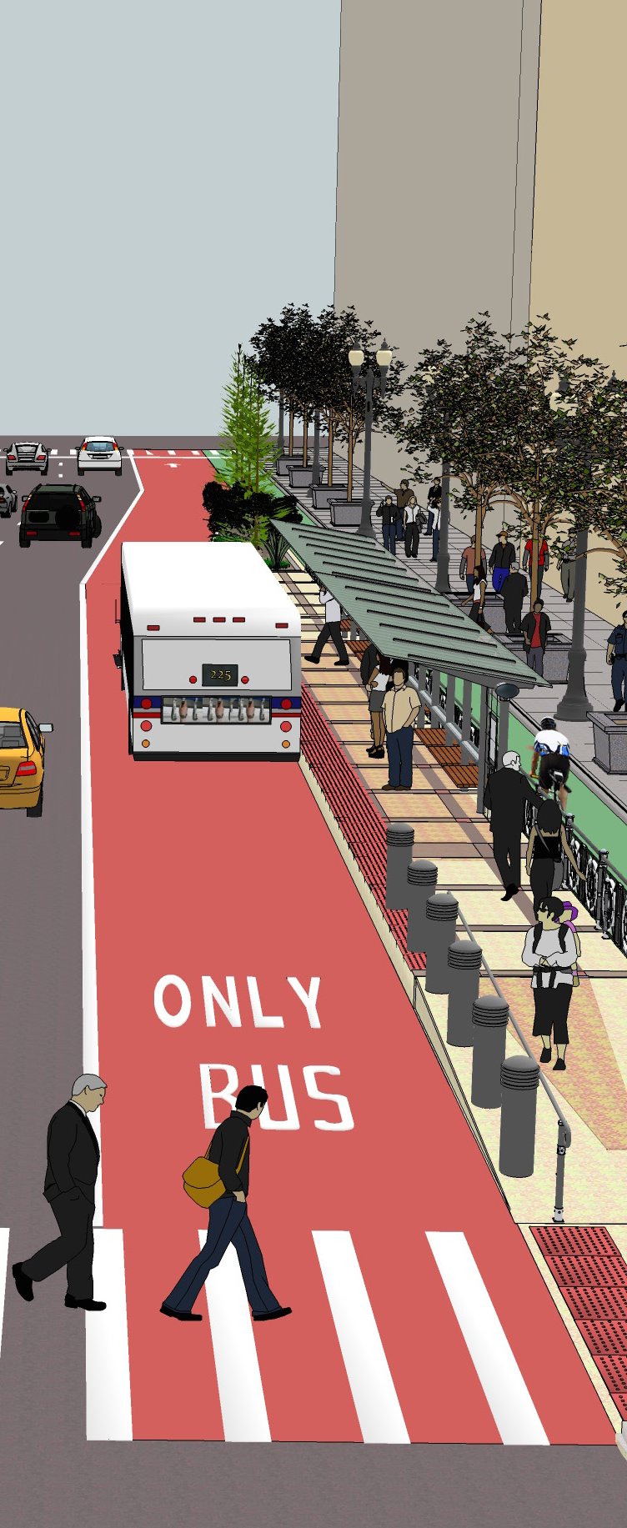
What is the New Starts program?
FTA’s primary grant program for capital investment in fixed-guideway public transit projects
Urban rail
Downtown people movers (monorail)
Light rail
Heavy rail/subway
Commuter rail
Bus rapid transit

Slide 5
The role of forecasting and cost estimation
Estimate of construction costs
Cost
Benefits
Cost effectiveness =
Estimate of future ridership

Slide 6
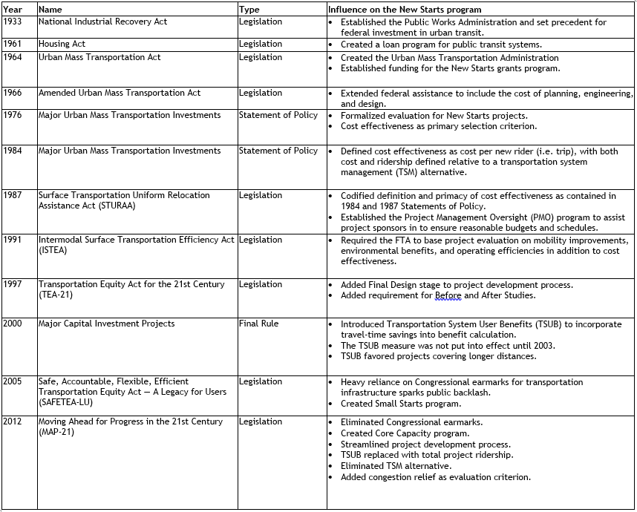
Changes to cost-effectiveness calculation
Addition of project evaluation criteria
Mobility improvement
Value of travel time savings
Number of low-income households within half mile
Environmental benefit
Value of emissions reduction
Change in energy consumption
Compliance with EPA air quality standards
Operating efficiencies (Change in operating cost per passenger mile)
Cost effectiveness (Cost per new rider)
Transit-supportive existing land-use policies and future patterns: Low, medium, or high, based on
Existing land use
Containment of sprawl
Transit-supportive policies
Performance of land-use policies
Other factors
The degree to which institutions are already in place as assumed in forecasts
Project management capability
Additional relevant factors
2005 Dear Colleague letter: Cost effectiveness rating of medium or better required for funding
2007 NPRM: Cost effectiveness weighted at 50% of project evaluation score
2008 SAFETEA-LU technical corrections act: criteria must be comparably weighted
Added economic development and land use as criteria

Slide 7
Common explanations for optimism bias

Slide 8
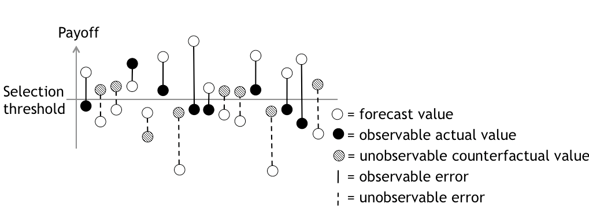
Explanations for bias
Technical/project specific
Defensible
Flawed models
Unforeseeable events
Incorrect assumptions
Selection bias
Systemic
Psychological
People really are optimistic
People are bad at anticipating setbacks
Ethical
Strategic misrepresentation

Slide 9
Differences between cost estimation and ridership forecasting

Slide 10
Difference in incentives
Ridership forecasts
Cost estimates
Predict ridership as high as possible/defensible.
Estimates need to be low enough to make the project look attractive,
But high enough that you get enough money to complete the project.

Slide 11
Difference in expertise
Travel demand modeling
Construction cost estimation
Models developed by transportation engineers
Models run by transportation engineers and planners
Basic model structure is a common part of a transportation planner’s/engineer’s education
For New Starts: Minimal oversight by Federal Transit Administration
Cost estimates developed by cost estimators, construction managers, and construction engineers
Cost estimation techniques are not a standard part of a transportation planner’s/engineer’s education
For New Starts: Relatively high level of guidance and oversight

Slide 12
Difference in perception of control
 | During project planning | During project construction | After project opening
Within the project sponsor’s control | Ridership forecasts | Observed cost
Beyond the project sponsor’s control | Cost estimates |  | Observed ridership

Slide 13
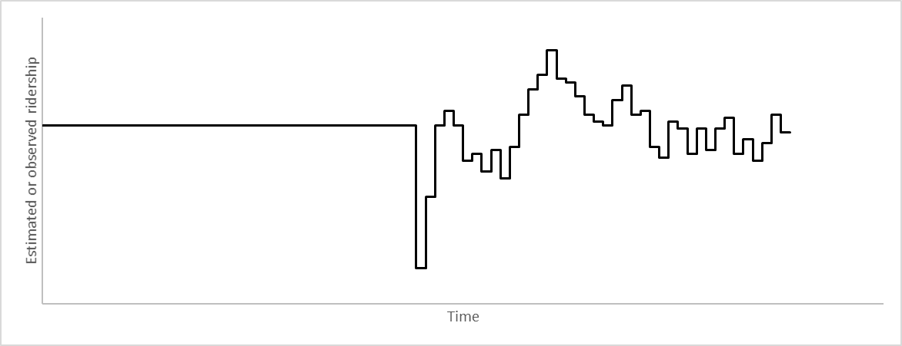
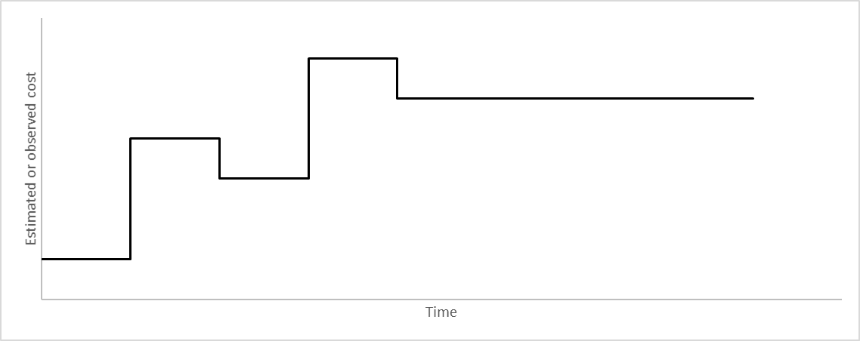
Difference in temporal variation
Ridership forecasts
Prepared once near the beginning of project development and engineering
Compared to observed ridership that varies over time
Cost estimates
Project opening
Refined/revised over the course of project development and engineering
Compared to a single final cost estimate

Slide 14

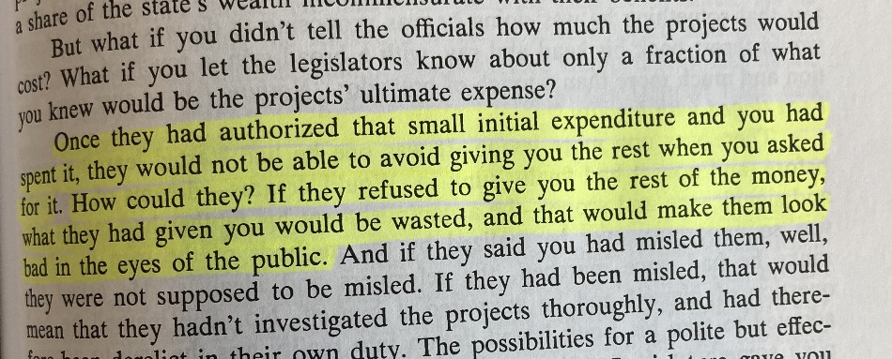
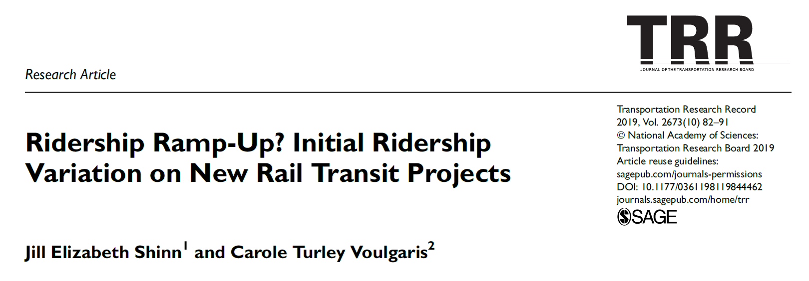
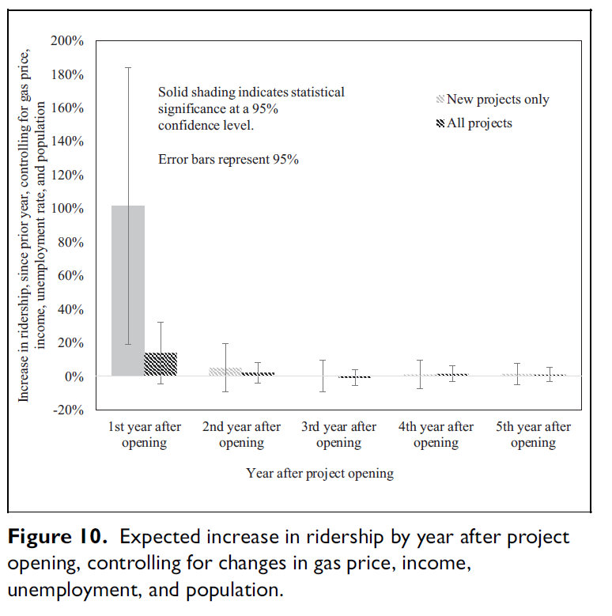
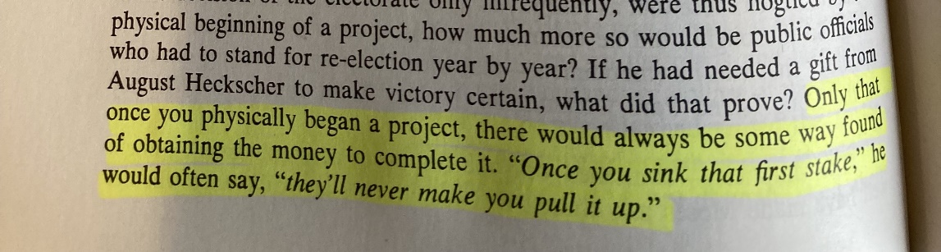
Accuracy compared to what?
Which observed ridership value?
Which cost estimate?
FTA: Two years after project opening
The earliest one?
The latest one?

Slide 15
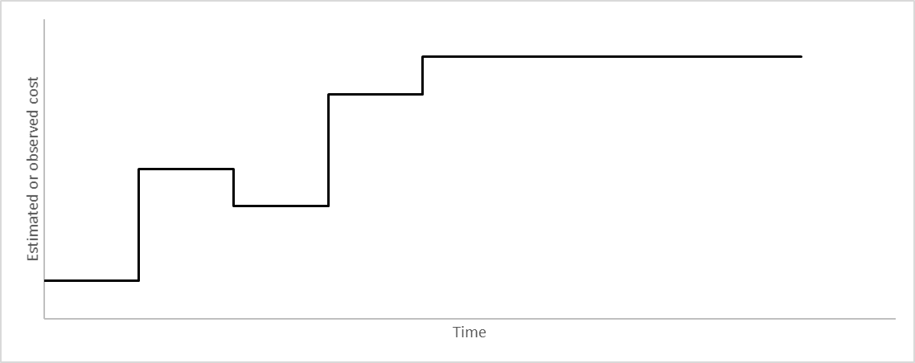
Cost escalation vs cost overrun
Cost escalation
Cost overrun
Increases in project costs over the course of project development
May be viewed as a project management problem or an ethics problem
Increase in project costs after construction begins
More likely to be viewed as a project management problem
Project opening

Slide 16
Relationships among forecasting/estimation errors

Slide 17
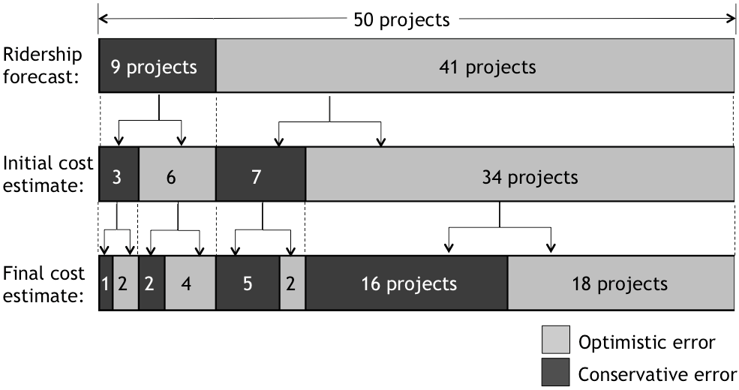
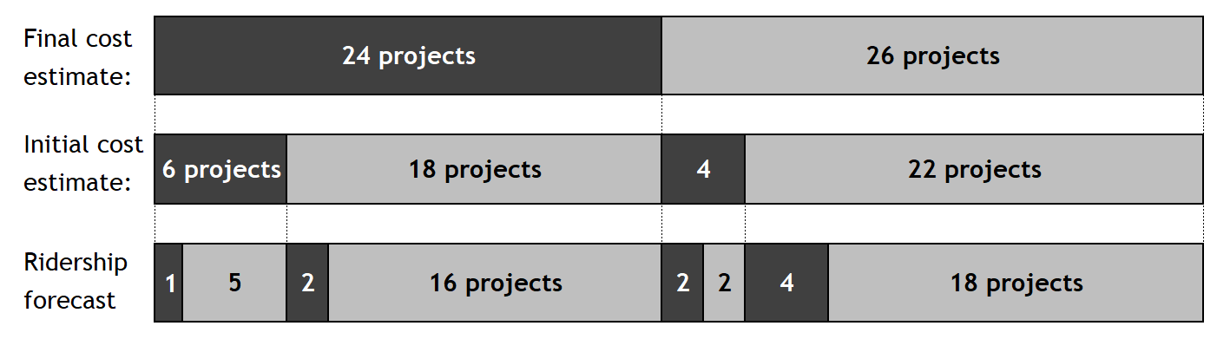
Relationship among errors
50 projects completed between 1989 and 2011 for which ridership forecasts are available in addition to initial and final cost estimates.

Slide 18
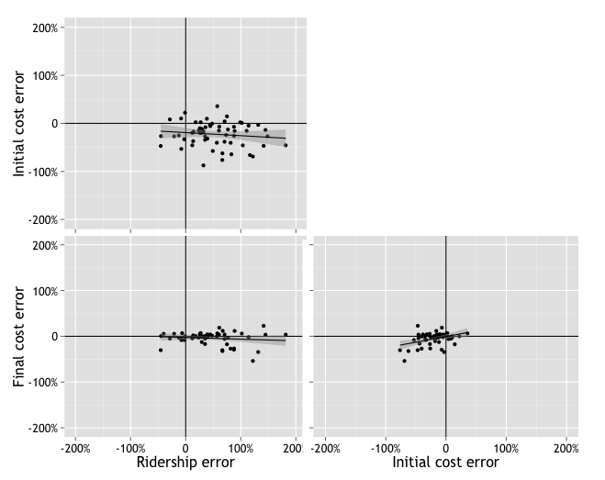
Relationship among errors
50 projects completed between 1989 and 2011 for which ridership forecasts are available in addition to initial and final cost estimates.
r = (-0.33, 0.13)
(Predicted – Observed)
Error =
(Predicted + Observed) / 2
r = (-0.38, 0.15)
r = (0.14, 0.60)

Slide 19
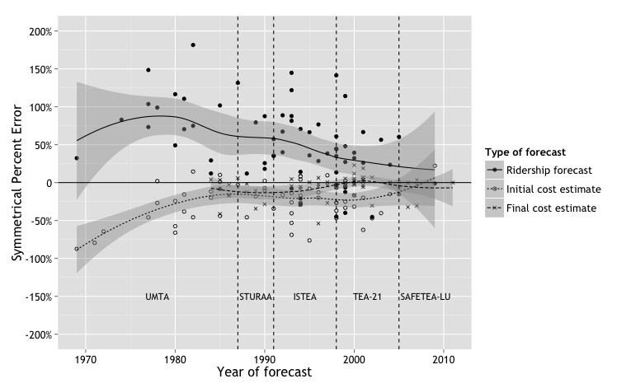
Change over time
r = (-0.59, -0.18)
r = (0.08, 0.53)
r = (-0.05, 0.44), median = 0.06%

Slide 20
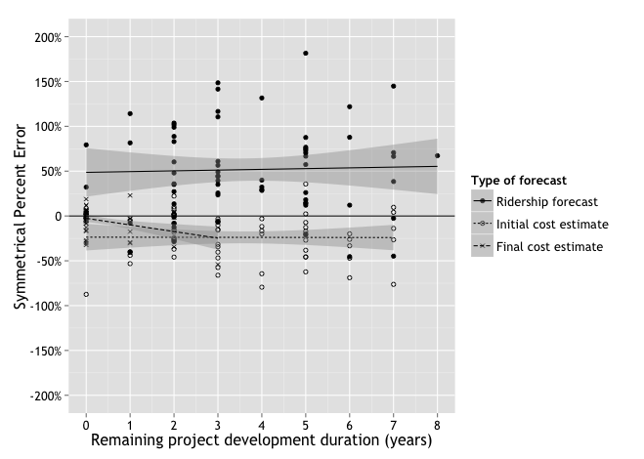
Relationship with project development duration
r = (-0.22, 0.28)
r = (-0.25, 0.25)
r = (-0.58, -0.14)
Of 59 projects with final cost estimates available:
44 began construction in the same year as the final cost estimate
51 had begun construction by the following year

Slide 21
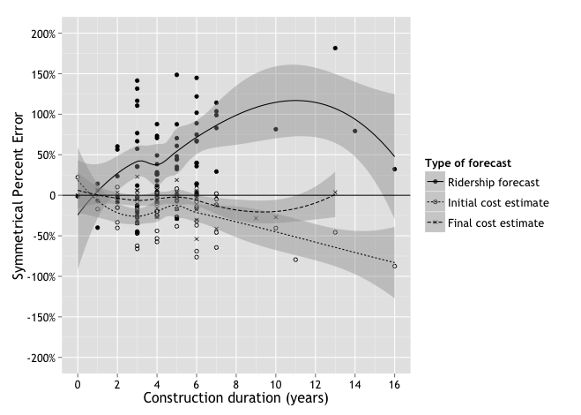
Relationship with construction duration
r = (0.16, 0.58)
r = (-0.58, -0.15)
r = (-0.43, 0.07)

Slide 22
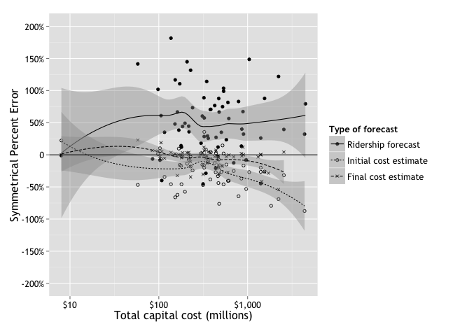
Relationship with project cost
r = (-0.23, 0.26)
r = (-0.64, -0.24)
r = (-0.57, -0.13)

Slide 23
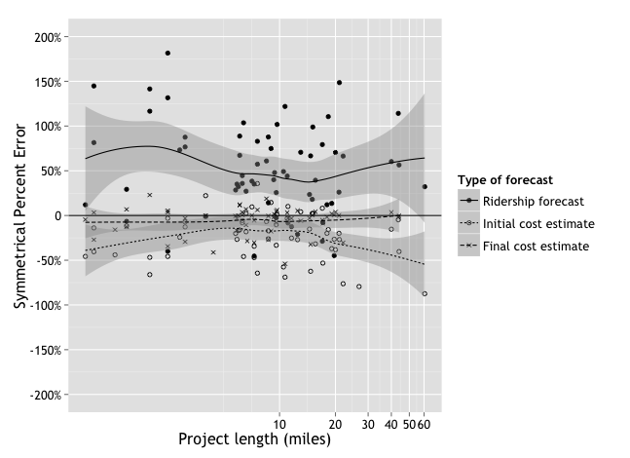
Relationship with project length
r = (-0.29, 0.20)
r = (-0.49, +0.0)
r = (-0.17, 0.34)

Slide 24
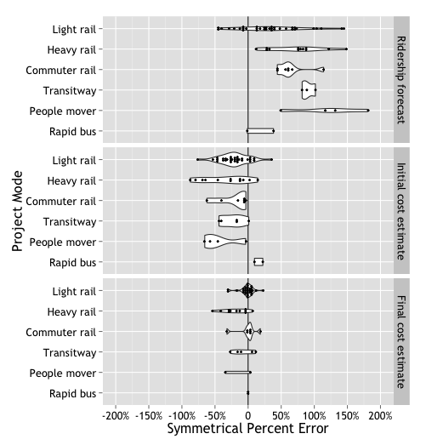
Relationship with mode
People movers have ridership forecast errors 18 to 154 percentage points greater than light rail (95-percent confidence)
No significant differences by mode
Cost estimates for light rail projects are 4 to 32 percentage points more accurate than those for heavy rail projects

Slide 25
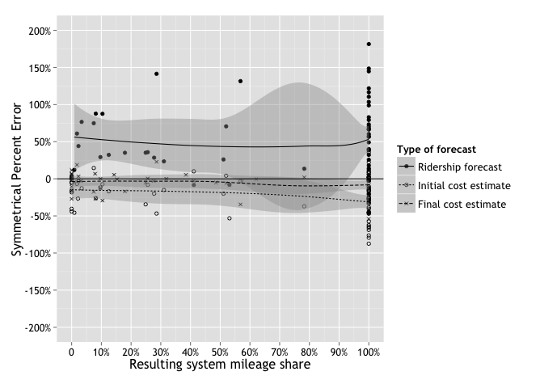
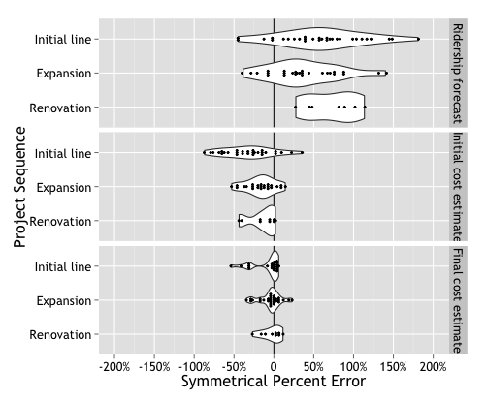
Relationship with sequence/experience
r = (-0.25, 0.28)
r = (-0.50, 0.04)
r = (-0.39, 0.12)
No significant differences by sequence

Slide 26
Summary of simple correlations
 | Forecast type
 | Cost estimate |  | Ridership forecast
 | Initial | Final
Time of forecast
Year | + | o | +
Governing legislation | o | o | o
Project characteristics
Elapsed time
Project development | o | — | o
Project construction | — | o | —
Financial characteristics
Total project cost | — | — | o
Physical characteristics
Project length | o | o | o
Project mode | o | ☐ | ☐
Local experience
Project sequence | o | o | o
Project share of new system miles | — | o | o
Relationship with accuracy, without controlling for other factors (95-percent confidence)
+ = Increase associated with improved accuracy
— = Increase associated with reduced accuracy
o = No significant relationship with accuracy
☐ = At least one pair of categories variables associated with a difference in accuracy

Slide 27
Relationships with controls (linear regression)
 | Forecast type
 | Cost estimate |  | Ridership forecast
 | Initial | Final
Time of forecast
Year | o | o | +
Governing legislation | o | o | o
Project characteristics
Elapsed time
Project development | o | o | o
Project construction | o | o | —
Financial characteristics
Total project cost | — | — | o
Physical characteristics
Project length | o | o | o
Project mode | ☐ | ☐ | ☐
Local experience
Project sequence | o | o | o
Project share of new system miles | o | o | o
95-percent confidence
+ = Increase associated with improved accuracy
— = Increase associated with reduced accuracy
o = No significant relationship with accuracy
☐ = At least one pair of categories variables associated with a difference in accuracy
90-percent confidence
+ = Increase associated with improved accuracy
— = Increase associated with reduced accuracy
o = No significant relationship with accuracy
☐ = At least one pair of categories variables associated with a difference in accuracy

Slide 28
Preliminary conclusions
Future
directions
Cost estimates –especially final cost estimates– have been more accurate than ridership forecasts.
Cost estimate error is not correlated with ridership forecast error.
Final cost estimate error is better than, but correlated with initial cost estimate error.
More costly projects experience higher cost estimation errors.
What external pressures, if any, create an incentive to misrepresent initial cost estimates?
To what degree are cost estimates self-fulfilling?
How do federal funding shares change with cost escalation?
What are the relationships between cost escalation and cost overrun?
Under what circumstances is a project abandoned?

Slide 29
Thank you.
Carole Voulgaris
Harvard Graduate School of Design
cvoulgaris@gsd.harvard.edu

